Slide 1
Simulation Study T-Test vs. Wilcoxon Test
STAT 7650
Zheran Rachel Wang

Slide 2
Content
Introduction
Goal
Method
Result
Conclusion

Slide 3
Introduction
Two sample T-Test:
a way to compare the responses to two treatments or to compare the characteristics of two populations.
Wilcoxon Rank Sum Test:
a nonparametric alternative to two sample t-test which only based on the order in which the observations from the two samples fall.

Slide 4
Introduction
Assumptions
For T-Test:
Two simple random sample from two distinct populations. Samples are independent.
Both populations are normally distributed.
For Wilcoxon Rank-Sum Test:
No distribution assumption
Nearly same as t-test when data is normal
Considerably better when outliers exists
Work for missing value

Slide 5
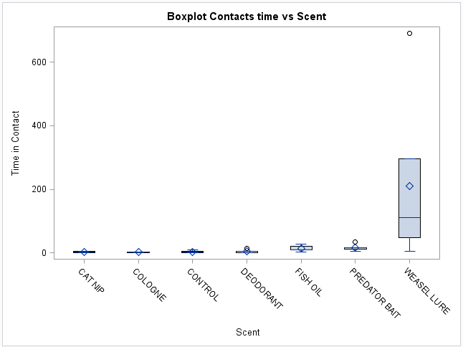
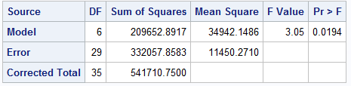
Introduction-Fosa Research
Analysis by using one-way ANOVA
With Power=0.9679340

Slide 6
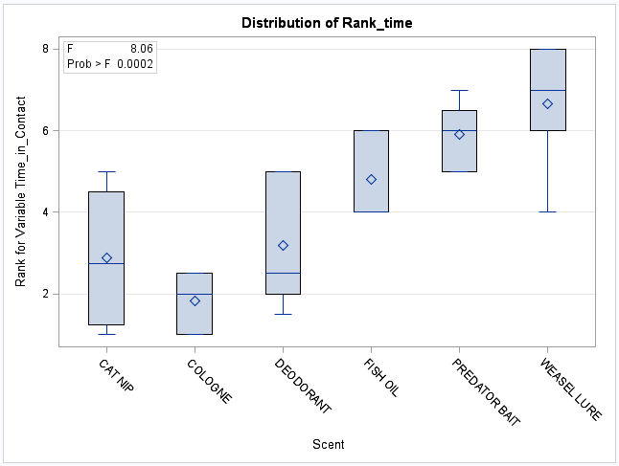
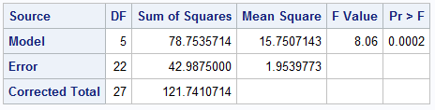
Introduction-Fosa Research
Analysis by using Friedman ANOVA
With Power=0.9967645

Slide 7
Goal
Use simulation study to proof that when sample size is small and with outlier, Wilcoxon Rank-Sum test will provide more reliable result than t-test.

Slide 8
Method
1. Consider different sample size n.
5, 50, 400, 1000
2. Consider different distribution.
Normal distribution
Mixture normal distribution
t-distribution with df=1
3. Performance measure: differences in Power.
Power(t-test) – Power(Wilcoxon test)
4. Iteration: 500

Slide 9
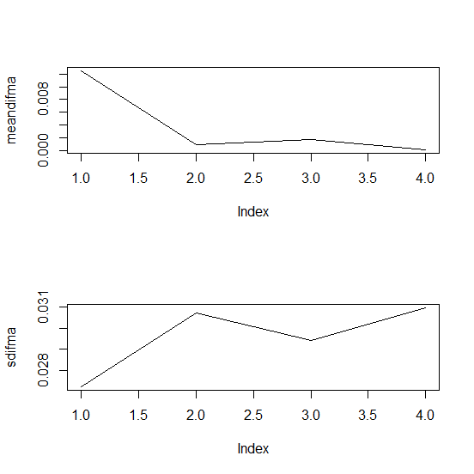
Result
Normal distribution
N | MEAN | Standard error
5 | 0.01252 | 0.02722
50 | 0.00098 | 0.03072
400 | 0.00168 | 0.02943
1000 | 0.00012 | 0.03097

Slide 10
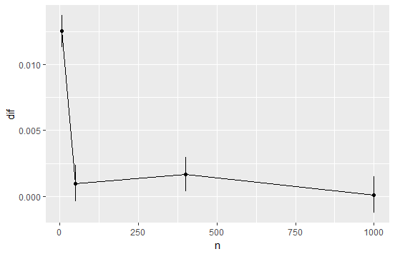
Result

Slide 11
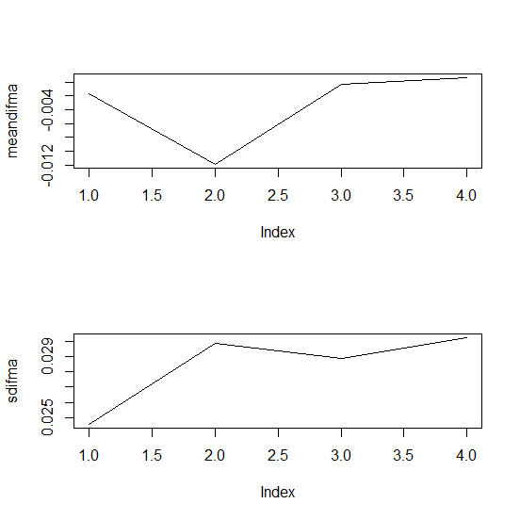
Result
Mixture normal distribution
N | MEAN | Standard error
5 | -0.00166 | 0.02457
50 | -0.01188 | 0.02988
400 | -0.00032 | 0.02890
1000 | 0.00066 | 0.03023

Slide 12
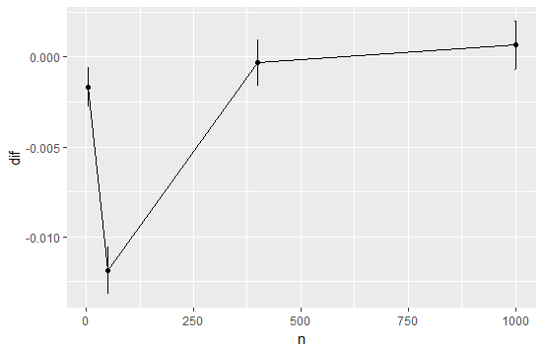
Result

Slide 13
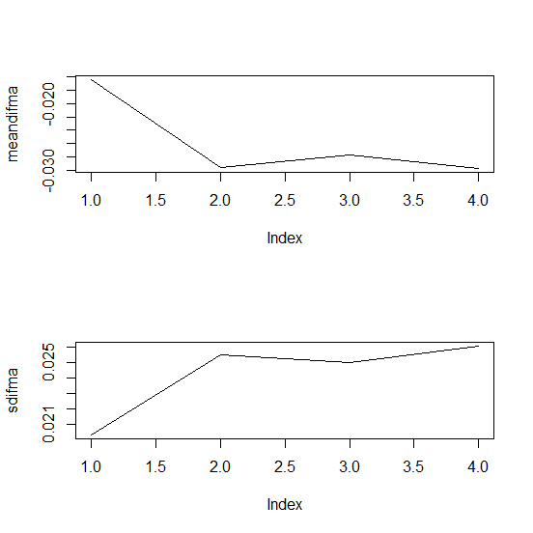
Result
t-distribution
N | MEAN | Standard error
5 | -0.01646 | 0.02031
50 | -0.02948 | 0.02551
400 | -0.02762 | 0.02499
1000 | -0.02966 | 0.02606

Slide 14
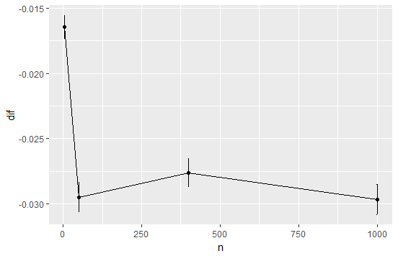
Result

Slide 15
Conclusion
Base on the result in this simulation study.
When sample distribution is normal, t-test tends to have more power than Wilcoxon Rank-Sum test.
When sample distribution is mixture normal, Wilcoxon Rank-Sum test appears more power when sample size is small.
When sample distribution is t-distribution, Wilcoxon Rank-Sum test tends to have more power than t-test.

Slide 16


